Slide 1
Analyzing Security Vulnerabilities and Developing Defense Mechanisms in Vehicular Ad Hoc Networks (VANET): A Simulation and Performance Evaluation Study
GRADUATION PROJECT (1)
Students
Supervisors
ريم رامي بعاج
وسيم جنيدي
عدنان صبري
محمد يامن حلاق
1 / 10

Slide 2
Project Objective and Previous Stages
Objective
Completed in the Semester Project
Study the VANET architecture, the sensitive nerve of smart transportation
Secure real-time V2V and V2I communication while preserving privacy and fast response
Analyze network behavior under cyberattacks (e.g., denial of service, message tampering)
Evaluate proposed defense algorithms in professional simulation environments
VANET architecture: layers and protocols
Literature review of VANET security (last 5 years)
Threat classification: attacks and weak points per protocol
Simulation tools: NS-3 with SUMO
Proposed attack and security solution discussed
2 / 10

Slide 3
VANET Challenges and Limitations
High mobility: topology changes constantly and links are short-lived
Open wireless medium: exposed to jamming, black hole and spoofing attacks
Strict latency: safety messages must arrive within milliseconds
Privacy vs. authentication: verifying vehicles without exposing identities
Scalability: performance drops in dense traffic
No central trust: decentralized nodes make malicious ones hard to detect
3 / 10

Slide 4
Literature Review (1/2)
Publisher / Journal | Year | Study | What it covered | Research gap | Comparison with our project
Inderscience, Int. J. Vehicle Information and Communication Systems | 2025 | Performance Analysis of AODV-Based VANETs in Guwahati City: A Comparative Study of Propagation Models [1] | AODV baseline in a city scenario (SUMO + NS-3) with different propagation models | No attacks or security evaluation | Used as our no-attack baseline; we add attacks on top of it
Jurnal Online Informatika (JOIN) | 2025 | Performance Evaluation of Vehicular Ad Hoc Networks Considering Malicious Node Impact on Quality of Services Metrics [2] | Black hole and wormhole impact on QoS; black hole raised packet loss from 29% to 59% | Measures the impact only; no detection or defense | Same SUMO + NS-3 setup; we also build a detection method
Springer, EURASIP J. Wireless Communications and Networking | 2025 | Discovering Authentic Routes Using a Cryptographic Approach Against Blackhole Attack [3] | Cryptographic authentication of RREQ/RREP in AODV; PDR of 57.5%–81.82% (40–100 nodes) | Prevention only; adds cryptographic overhead | Behavioral detection from packet traces, without key management
4 / 10

Slide 5
Literature Review (2/2)
Publisher / Journal | Year | Study | What it covered | Research gap | Comparison with our project
Int. J. Innovative Research and Scientific Studies | 2025 | GAN-Augmented Adversarial Training for Robust Detection of Complex Jamming Attacks in VANET Intelligent Systems [4] | GAN-augmented CNN–Random Forest jamming detection; 93.4% F1-score | Jamming only; focuses on the detection model | We simulate jamming and measure its impact on the network
Int. J. Intelligent Engineering and Systems (IJIES) | 2025 | Leveraging DenseNet-ABiLSTM for Effective Jamming Attack Detection in VANETs [5] | DenseNet-ABiLSTM jamming detection; 98.7% binary accuracy | Jamming only; dataset-based deep learning | We combine jamming and black hole in one simulated VANET
Research gap
Few studies evaluate black hole and jamming attacks, with detection, in one realistic SUMO + NS-3 scenario.
5 / 10

Slide 6
Implementation Phases and Tools
1
2
3
4
5
Scenario design
Normal case
Jamming
Black hole
Impact analysis
Real city map and traffic density/speed in SUMO
Run without attacks and extract KPIs (delay, packet loss)
Physical-layer attack simulation
Network-layer routing attack involving malicious packet dropping and potentially forged AODV route replies
Measure network efficiency degradation
Tools used
SUMO
NS-3
Python + TraCI
Ubuntu on VMware
Traffic mobility
Network simulation
Integration and visualization
Platform
6 / 10

Slide 7
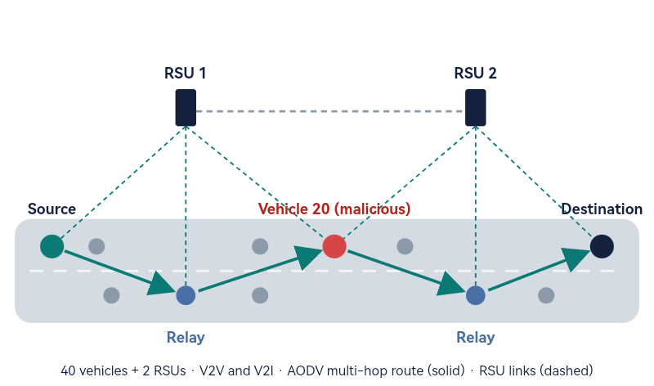
Proposed Network Topology and AODV Header
AODV RREQ header (32 bits per row)
Type = 1
J R G D U
Reserved
Hop Count
RREQ ID
Destination IP Address
Destination Sequence Number
Originator IP Address
Originator Sequence Number
AODV RREP header
Type = 2
R A
Reserved
Prefix Sz
Hop Count
Destination IP Address
Destination Sequence Number
Originator IP Address
Lifetime
A forged RREP advertises an inflated destination sequence number (highlighted) [6]
7 / 10

Slide 8
Experimental Results
Network Performance Under Attack
Metric | Normal | Under Attack
Sent Packets | 42 | 42
Received Packets | 36 | 25
PDR | 85.71% | 59.52%
Packet Loss | 6 | 17
Throughput | 0.6588 Kbps | 0.451 Kbps
Average Delay | 59.39 ms | 58.20 ms
8 / 10

Slide 9
Where We Stopped and What Continues
We stopped at: Black Hole stage 1 (malicious packet dropping) with offline detection
Continuing now: forged RREP, then physical-layer Jamming
Completed
Continuing Now (Future Work)
VANET simulation with 40 vehicles and 2 RSUs using NS-3 and SUMO
AODV-based multi-hop network simulation
Baseline performance evaluation
Malicious packet-dropping implementation
Offline behavioral Black Hole detection using packet reception and forwarding traces
Detection evaluation under different attacker configurations
SUMO visualization of the malicious vehicle
Complete Black Hole attack using forged RREP messages
Implement physical-layer Jamming attack
Extend detection evaluation across more scenarios
Improve real-time attack detection and mitigation
9 / 10

Slide 10
References
[1] R. J. Borah and D. Ganga, “Performance analysis of AODV-based VANETs in Guwahati city: a comparative study of propagation models,” Int. J. Vehicle Information and Communication Systems, vol. 10, no. 1, pp. 61–84, 2025.
[2] N. F. Alfarizi, M. T. Nuruzzaman, S. Uyun, B. Sugiantoro, and M. F. A. bin Abdullah, “Performance Evaluation of Vehicular Ad Hoc Networks Considering Malicious Node Impact on Quality of Services Metrics,” Jurnal Online Informatika, vol. 10, no. 2, pp. 299–307, 2025.
[3] M. Ghute and Y. Suryawanshi, “Discovering authentic routes using a cryptographic approach against blackhole attack,” EURASIP J. Wireless Commun. Netw., vol. 2025, Art. no. 86, 2025.
[4] N. A. K. Zghair, W. K. Jawad, J. J. Alwash, M. A. Almaiah, and R. Shehab, “GAN-augmented adversarial training for robust detection of complex jamming attacks in VANET intelligent systems,” Int. J. Innovative Research and Scientific Studies, vol. 8, no. 3, pp. 4304–4314, 2025.
[5] A. S. Srinivas T et al., “Leveraging DenseNet-ABiLSTM for Effective Jamming Attack Detection in VANETs: A Hybrid Model with DRA-driven Feature Optimization,” Int. J. Intelligent Engineering and Systems, vol. 18, no. 11, 2025.
[6] C. Perkins, E. Belding-Royer, and S. Das, “Ad hoc On-Demand Distance Vector (AODV) Routing,” RFC 3561, IETF, Jul. 2003.
10 / 10

